Slide 1

Embedded System and Internet of Things (ESIOT)
Introduction to Embedded Systems (Unit-1):
B.E.-CSE 3rd Sem.
Department of Interdisciplinary Courses in Engineering (DICE)

Slide 2
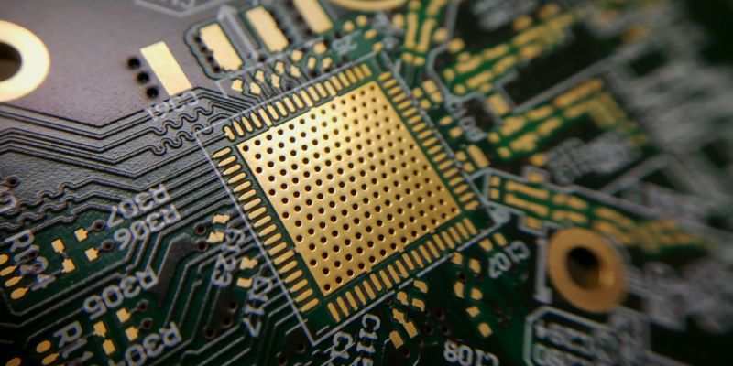
Embedded system
A combination of hardware and software where software is embedded into the hardware.
Dedicated to either application(s) or specific parts or product or component of a large system.
Managed by microcontrollers or digital signal processors (DSP), application-specific integrated circuits (ASIC), field-programmable gate arrays (FPGA), GPU technology, and gate arrays.
It can be small independent system or large combinational system.

Slide 3
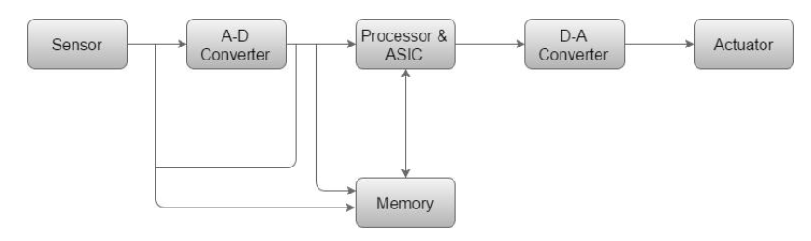
Basic Structure of Embedded system

Slide 4
Basic Structure of Embedded system
Sensor: The sensor measures and converts the physical quantity to an electrical signal, which can then be read by an embedded systems engineer or any electronic instrument
A-D Converter: An analog-to-digital converter converts the analog signal sent by the sensor into a digital signal.
Processor & ASICs: Processors assess the data to measure the output and store it to the memory.
D-A Converter: A digital-to-analog converter changes the digital data fed by the processor to analog data
Actuator: An actuator compares the output given by the D-A Converter to the actual output stored and stores the approved output.

Slide 5
Components of Embedded system
Hardware
Application software
Real Time Operating system (RTOS)
Component physically connected with an embedded system comprises of microcontroller based integrated circuit, power supply, LCD display etc.
Allows the user to perform varieties of application to be run on an embedded system by changing the code installed in an embedded system.
Supervises the way an embedded system work. Interface between hardware and application software. Provide mechanism to let the processor run on the basis of scheduling for controlling the effect of latencies.

Slide 6
Hardware Components of Embedded system
Power Supply
Microcontroller and microprocessor
Memory
Processors range from 8-bit to 16-bit to 32-bit, with the main difference in processing speed and throughput.
A 5V power supply is generally required, the range can go from 1.8V to 3.3V, depending on the application.
Two types of memory are RAM (random access memory) and ROM (read-only memory).
Timer and counter
Timers are used in applications delays are used before the execution of a specific function. Counters are used where the number of times a specific event takes place needs to be tracked.

Slide 7
Hardware Components of Embedded system
Input/output
Communication interface
Electrical circuit
Input components allow other components within the larger interconnected infrastructure to interact with the embedded system. Once processing is complete, the results are communicated to the required destination via the output component.
Communication interfaces enable embedded systems to establish communications with each other and other components within the larger system. Different interfaces include USB, I2C, UART, RS-232, and SPI.
Depending on the application, embedded systems can contain customized electrical circuits comprising of Printed circuit board (PCB), resistor, capacitor, diode, transistor, inductor, LED

Slide 8
Software Components of Embedded system
Text editor
Compiler
Assembler
A text editor is the first software component needed for building an embedded system. This editor is used to write source code in C and C++ programming languages and save it as a text file.
This component’s core function is the development of an executable program. Translates the written code into low-level machine language such as machine code, assembly language, and object code.
The assembler is used when assembly language is the programming language used to build the application. The assembly language program is translated into HEX code for further processing. Once the code is written, the programmer is used to write the program on the chip.

Slide 9
Software Components of Embedded system
Emulator
Link editor
Debugger
It makes the embedded system behave like a real, live system while operating in a simulation environment. The emulator is used to gain an idea of the way the code will operate in real time.
Software code is generally written in small-sized pieces and modules. The link editor, also known as a ‘linker,’ is the component used to take one or more object files and integrate them to develop a single executable code.
A software component used for debugging and testing. It is responsible for scanning the code, removing bugs and other errors, and highlighting the specific instances where they occurred. The debugger helps programmers address errors swiftly.

Slide 10
Embedded Processor?
An embedded processor is a microprocessor that is used in an embedded system. An embedded system is a computer system that is designed to perform a specific task within a larger system. It is a self-contained system that is embedded within a larger device or system and is used to control the operation of the device.
Embedded processors are typically found in devices that require real-time processing capabilities, such as industrial control systems, automotive systems, and consumer electronics.
Embedded processors are designed to be small, low-power, and efficient, as they are typically used in devices where space and power are at a premium.
They are also designed to be reliable and to operate for long periods of time without failure.
Some examples of devices that use embedded processors include smartphones, TVs, washing machines, and aircraft systems.

Slide 11
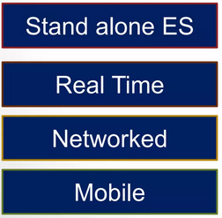
Types of Embedded System

Slide 12
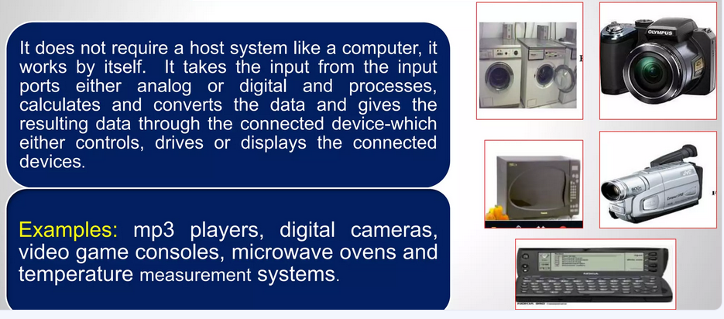
Stand-alone Embedded System

Slide 13
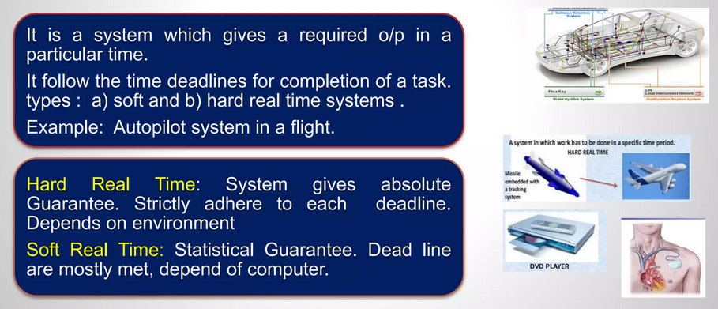
Real Time/ Reactive Embedded System

Slide 14
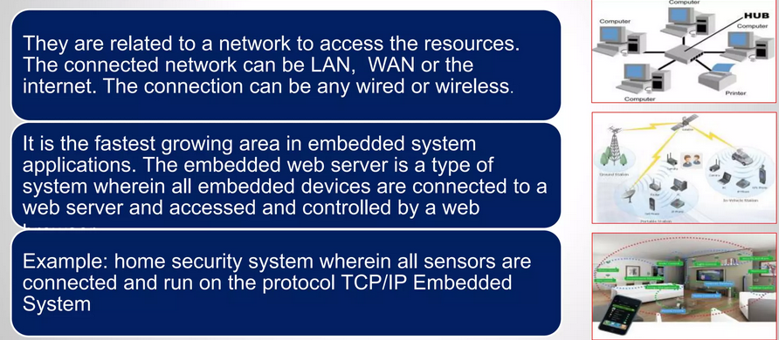
Network Embedded Systems

Slide 15
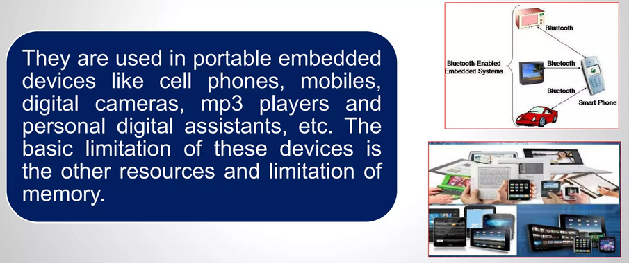
Mobile Embedded System

Slide 16
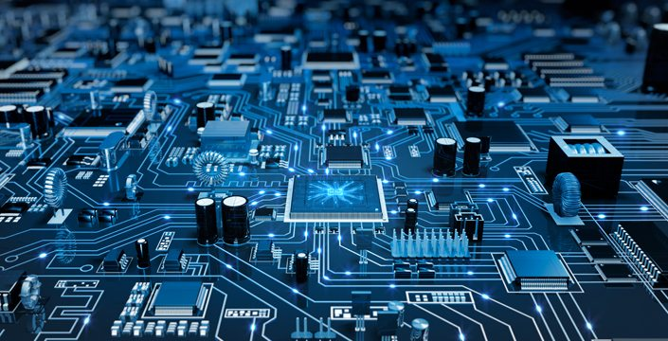
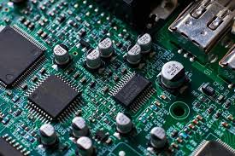
Schematic View of Embedded system

Slide 17
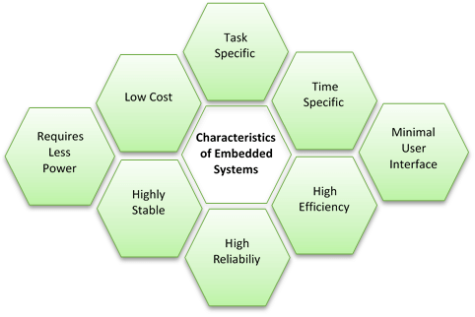
Characteristics of Embedded System

Slide 18
Characteristics of Embedded System
Task Specific: Embedded systems are designed to perform specific tasks or functions. They are optimized for the particular task they are intended to perform, which makes them more efficient and reliable.
Low Cost: Embedded systems are typically designed to be cost-effective. This is because they are often used in large volumes, and the cost per unit must be low to make the product economically viable.
Time Specific: Embedded systems must operate within a specific time frame. This is important in applications such as industrial control systems, where timing is critical for safety and efficiency.
Low Power: Embedded systems are designed to operate with minimal power consumption. This is important for applications where the system needs to operate for extended periods on battery power or where power consumption needs to be minimized to reduce operating costs.

Slide 19
Characteristics of Embedded System
High Efficiency: Embedded systems are designed to be highly efficient in terms of processing power, memory usage, and energy consumption. This ensures that they can perform their specific task with maximum efficiency and reliability.
Minimal User Interface: Many embedded systems do not require a complex user interface. They are often designed to operate autonomously or with minimal user intervention.
Highly Stable: Embedded systems are typically designed to be stable and reliable. They are often used in applications where failure is not an option, such as in medical devices or aviation.
High Reliability: Embedded systems are designed to operate reliably and consistently over long periods. This is important in applications where downtime can be costly or dangerous.

Slide 20
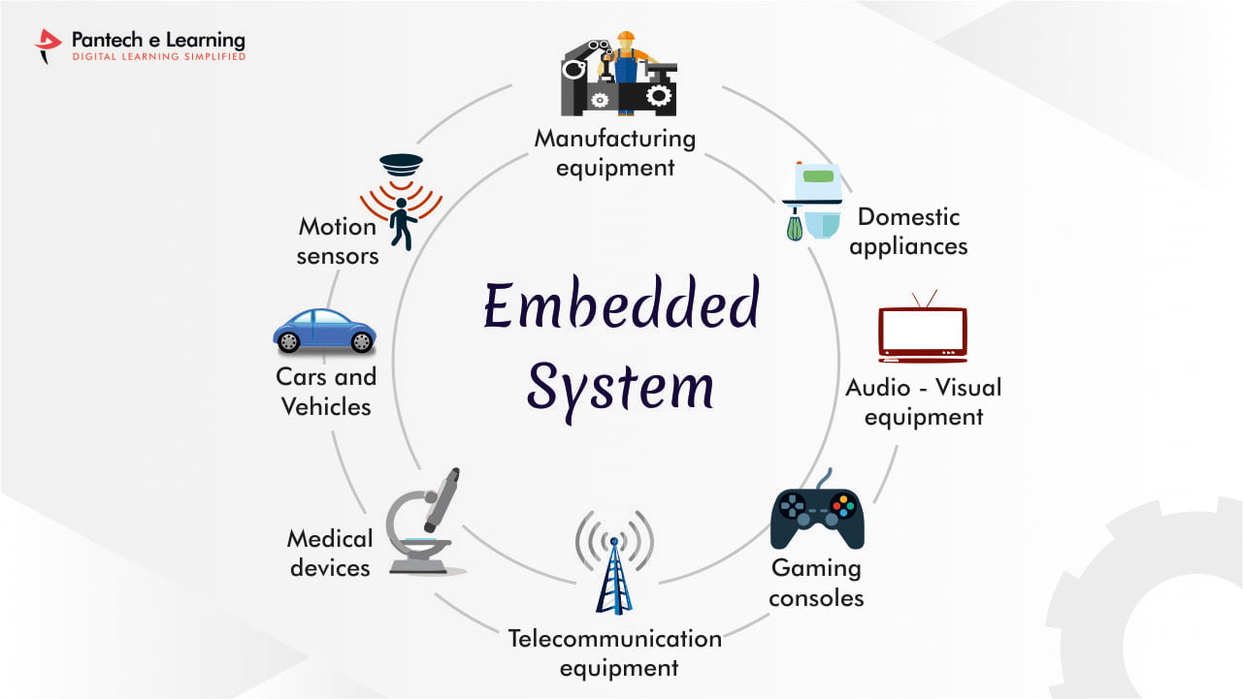
Applications of Embedded System

Slide 21
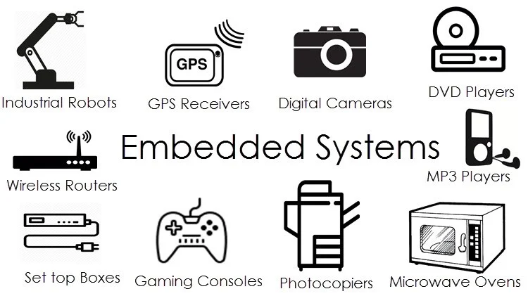
Applications of Embedded System

Slide 22
Applications of Embedded System
Consumer Electronics: Smartphones, digital cameras, televisions, and home appliances.
Automotive Industry: Engine management, airbag control, and infotainment systems.
Aerospace Industry: Flight control systems, navigation systems, and communication systems.
Medical Devices: Pacemakers, blood glucose monitors, and MRI machines.
Industrial Automation: Process control, factory automation, and robotics.
Security and Surveillance: Access control systems, CCTV systems, and biometric systems.
Defense and Military: Weapon systems, communication systems, and surveillance systems.
Home Automation: Smart thermostats, smart lighting systems, and security systems.

Slide 23
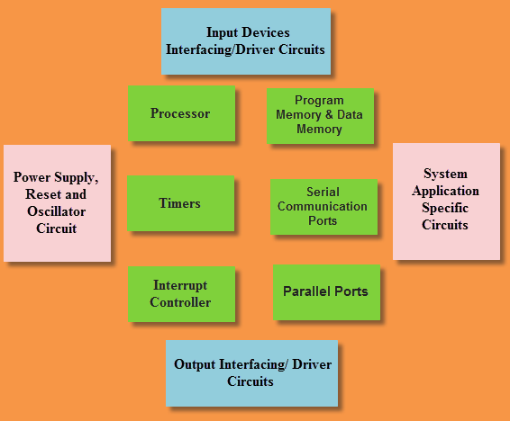
Block Diagram of Embedded Systems Architecture

Slide 24
Hardware Architecture
1. Microcontroller/Microprocessor: These components serve as the computational engine, executing instructions to carry out specific tasks. Microcontrollers are preferred in embedded systems due to their integrated features, including CPU, memory, timers, and peripheral interfaces, all on a single chip.
2. Memory: Memory is a critical component in embedded systems, and it comes in two primary types: RAM (Random Access Memory) and ROM (Read-Only Memory). RAM is used for temporary data storage during program execution, while ROM stores the firmware or software that is permanently embedded in the system.
3. Input and Output Interfaces: These interfaces connect the system to sensors, actuators, displays, and communication devices. The choice and design of these interfaces depend on the specific application requirements.

Slide 25
Hardware Architecture
4. Peripherals: Peripherals include additional components that enhance the capabilities of the embedded system. Examples include communication modules (UART, SPI, I2C), analog-to-digital converters (ADC), timers, and interrupt controllers. These peripherals extend the functionality of the core system.
5. Power Management: Embedded systems often operate in environments with varying power constraints. Efficient power management is crucial to extend the system’s battery life or minimize power consumption. Techniques such as sleep modes, power gating, and dynamic voltage scaling are employed to achieve optimal power efficiency.

Slide 26
Software Architecture
1. Operating System: Depending on the complexity of the embedded, Real-time operating systems (RTOS) are common in applications requiring precise timing and responsiveness. For simpler systems, a bare-metal approach may be adopted, where the software directly interacts with the hardware.
2. Device Drivers: Device drivers act as a bridge between the operating system and the hardware, facilitating communication and control. Well-designed device drivers are crucial for efficient utilization of hardware resources and ensuring seamless operation.
3. Application Software: The application software is tailored to the specific functionality of the embedded system. This software layer defines how the system responds to inputs, processes data, and generates outputs. Optimization is key to ensuring that the application software meets performance requirements within the given hardware constraints.

Slide 27
Design Considerations
1. Scalability: The architecture of an embedded system should be scalable to accommodate future updates and enhancements. This is particularly important as technology evolves, and new features or functionalities may need to be integrated into existing systems.
2. Reliability: Embedded systems are often deployed in mission-critical applications where reliability is paramount. Redundancy, error handling mechanisms, and fault tolerance strategies are integrated into the architecture to ensure uninterrupted operation.
3. Security: As embedded systems become more interconnected, security becomes a critical consideration. Robust security measures, including encryption, secure boot mechanisms, and access controls, are implemented to protect against unauthorized access and data breaches.
4. Testing and Validation: Rigorous testing and validation are essential components of embedded system development. Given the diverse applications of embedded systems, testing methodologies must account for real-time behavior, environmental variations, and potential hardware failures.

Slide 28
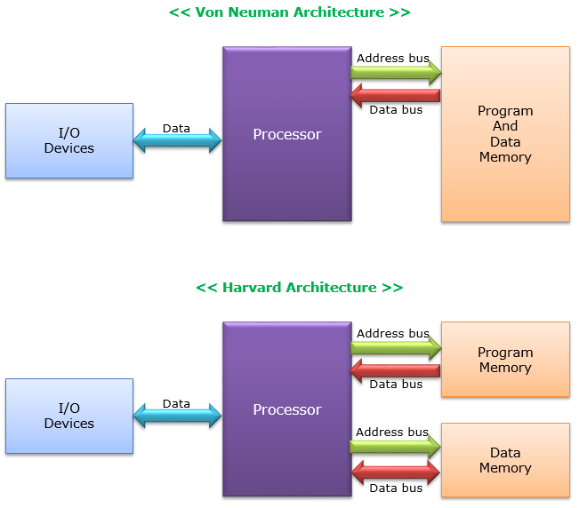
Von Neumann Architecture
Proposed by a computer scientist John von Neumann.
In this architecture, one data path or bus exists for both instruction and data.
The CPU does one operation at a time. It either fetches an instruction from memory, or performs read/write operation on data.
An instruction fetch and a data operation cannot occur simultaneously, sharing a common bus.
Von-Neumann architecture supports simple hardware. It allows the use of a single, sequential memory.
Notes:
Today's processing speeds vastly outpace memory access times, and we employ a very fast but small amount of memory (cache) local to the processor.

Slide 29
Harvard Architecture
The Harvard architecture offers separate storage and signal buses for instructions and data.
This architecture has data storage entirely contained within the CPU, and there is no access to the instruction storage as data.
Computers have separate memory areas for program instructions and data using internal data buses, allowing simultaneous access to both instructions and data.
Programs needed to be loaded by an operator; the processor could not boot itself.
There is no need to make the two memories share properties.

Slide 30
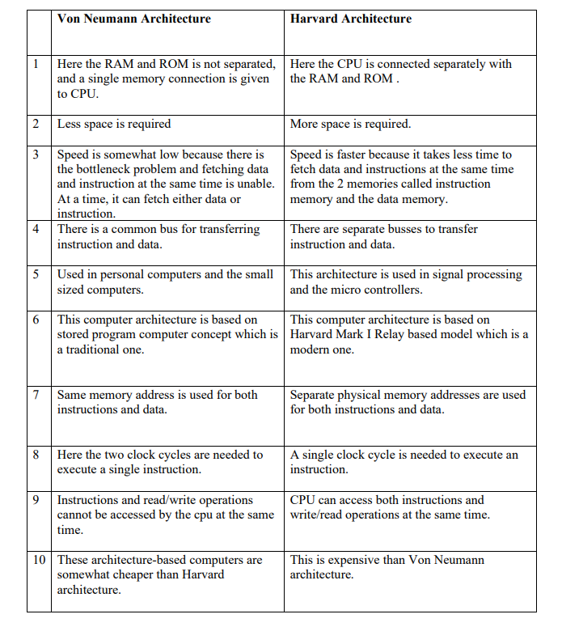
Hardware Components of Embedded system
Notes:
Input components allow other components within the larger interconnected infrastructure to interact with the embedded system. Once processing is complete (for instance, counting), the results are communicated to the required destination via the output component.
2) Depending on the application, embedded systems can contain customized electrical circuits. Some of the basic components used in electrical circuits of embedded systems are Printed circuit board (PCB), resistor, capacitor, diode, transistor, inductor, LED

Slide 31
Application Specific Integrated Circuit (ASIC)
What is an ASIC Chip (Application Specific Integrated Circuit)?
ASICs are integrated circuits that are specifically designed and tailored for a particular application or use.
Unlike general-purpose integrated circuits that can be used in a variety of devices, they are usually created from the ground up, based on the specific needs of the application they are intended for.
Examples include chips found in toys or those used for the interfacing of memory and microprocessors.

Slide 32
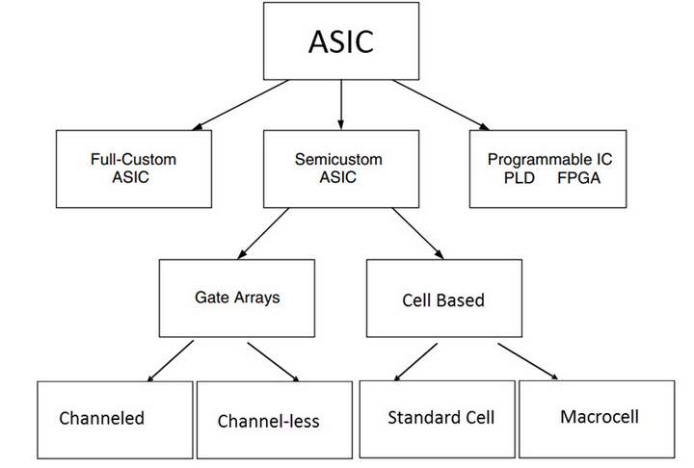
Types of ASIC
.

Slide 33
Types of ASIC
1. Full Custom ASICs
These ASICs are designed from the ground up for a specific application. Every aspect of the chip, from the logic gates to the layout of the circuit, is custom-made to meet the precise requirements of the intended application.
Full custom ASICs offer the highest performance and the lowest power consumption, but they are also the most expensive and time-consuming to design and manufacture.
They are typically used in applications where the volume is high enough or the performance requirements are strict enough to justify the additional cost and effort.
2. Semi-Custom ASICs
Semi-custom ASICs, including Standard Cell ASICs and Gate Array ASICs, offer a balance between customization and cost.
Standard Cell ASICs: In standard cell-based ASIC design, a standard cell library contains pre-designed logic cells like AND gates, OR gates, multiplexers, and flip-flops.
These cells are standardized and stored for use in ASIC chip designs.
The ASIC chip typically includes a standard cell area or flexible block, made up of these cells arranged in rows, and may also incorporate mega cells such as microcontrollers or microprocessors, referred to as mega functions, system-level macros, or fixed blocks/functional standard blocks.

Slide 34
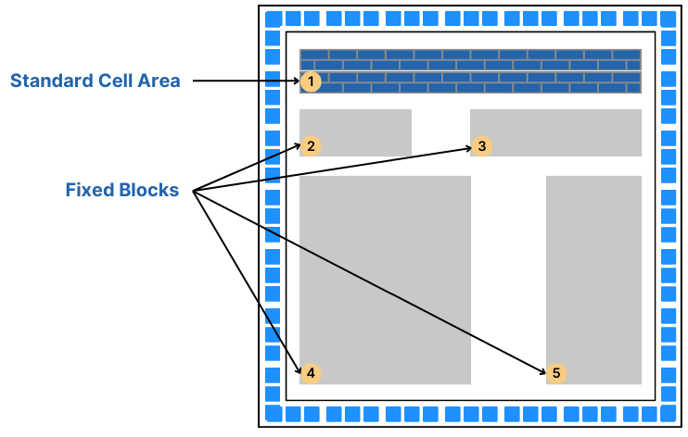
Standard Cell ASIC
Standard Cell ASIC

Slide 35
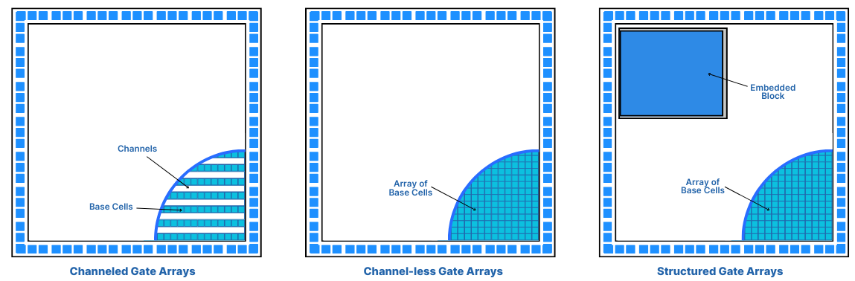
Gate Array ASIC
Gate Array ASICs: Gate Array ASICs are a type of semi-custom ASIC with predefined transistors on the silicon wafer, where the designer cannot alter the transistor placement but can change the interconnections between them using the die's initial metal layers.
The design utilizes a gate array library for configuration, typically resulting in Channeled, Channel-less, or Structured Gate Arrays, each varying in interconnection approach. This method, known as Masked Gate Array, relies on a base array pattern and base cells for circuit design.

Slide 36
Gate Array ASIC and Programmable ASIC
Channeled Gate Arrays: Utilize predefined routing channels between logic cells for wire connections, suitable for standardized designs needing flexible interconnect pathways.
Channel-less Gate Arrays: Lack predefined routing channels, allowing more compact designs by placing interconnects directly over cells, enhancing chip density.
Structured Gate Arrays: Combine predefined logic blocks with customizable interconnect layers, offering a balance between design flexibility and rapid development.
3. Programmable ASICs
Programmable Logic Devices (PLD): a type of digital integrated circuit that can be programmed to perform a wide range of logical operations. They are used in various applications to implement custom logic circuits without the need for custom semiconductor manufacturing.
FPGAs: Reprogrammable and can be used for various applications. They can be configured by the user after manufacturing according to different needs.

Slide 37
Applications of ASIC
The distinct characteristics of ASICs have transformed electronic manufacturing, leading to smaller die sizes and greater logic gate density per chip.
Typically chosen for advanced applications, ASIC chips serve as IP cores in satellites, are crucial in ROM production, and are utilized in microcontrollers, as well as in a wide array of medical and research applications.
Currently, one of the most notable uses of ASIC technology is in Bitcoin mining.

Slide 38
Embedded Networking and Standards
Communication Interface:
Communication interface is essential for communicating with various subsystems of the embedded system and with the external world.
The communication interface can be viewed in two different perspectives, namely:
1. Device/board level communication interface (Onboard Communication Interface)
2. Product level communication interface (External Communication Interface)

Slide 39
Embedded Networking and Standards
Device/board level communication interface (Onboard Communication Interface):
The communication channel which interconnects the various components within an embedded product is referred as Device/board level communication interface (Onboard
Communication Interface)
Examples: Serial interfaces like I2C, SPI, UART, Parallel bus interface etc.

Slide 40
Embedded Networking and Standards
2. Product level communication interface (External Communication Interface):
The Product level communication interface (External Communication Interface) is responsible for data transfer between the embedded system and other devices or modules. The external communication interface can be either wired media or wireless media and it can be a serial or parallel interface.
Examples for wireless communication interface: Infrared (IR), Bluetooth (BT), Wireless LAN (Wi-Fi), Radio Frequency waves (RF), GPRS etc.
Examples for wired interfaces: RS-232C/RS-422/RS 485, USB, Ethernet (TCP-IP), Parallel port etc.

Slide 41
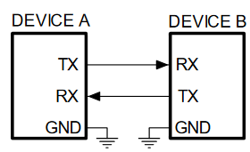
Serial Communication-RS232
A popular way to transfer commands and data between a personal computer and a microcontroller is the use of standard interface, like the one described by protocols RS232 (older) or USB (newer).
The protocol RS232 defines the signals used in communication, and the hardware to transfer signals between devices.

Slide 42
Serial Communication-RS232
An RS232 serial bus consists of just two communication wires - one for sending data and another for receiving. As such, serial devices should have two serial pins: the receiver, RX, and the transmitter, TX.
RS232 data is sent serially, each bit is sent one after the next because there is only one data line in each direction. This mode of data transmission also requires that the receiver knows when the actual data bits are arriving so that it can synchronize itself to the incoming data.

Slide 43
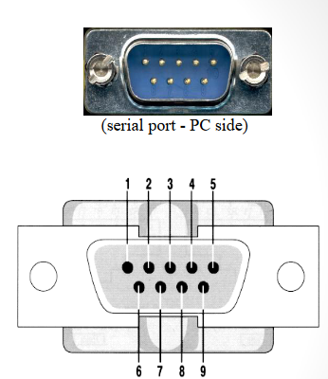
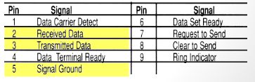
Serial Communication-RS232
RS-232 Signals:
Architecturally RS-232 is a bi-directional point to point link.
Two independent channels are established for two-way (full-duplex) communications.
RS-232 can also carry additional signals used for flow control (RTS, CTS) and modem control (DCD, DTR, DSR, RI).

Slide 44
Serial Communication-RS232
How fast can RS-232 be?
• The maximum speed, according to the standard, is 20kbit/s. However, modern equipment can operate much faster than this. (i.e. Lynx can reach 115200 baud rate.)
• The length of the cable also plays a part in maximum speed. The longer the cable the slower the speed at which you can obtain accurate results.
• A large wire capacitance and inductance limits the maximum length of the cable and/or the maximum speed; Moreover higher is the capacitance of the cable higher is the interference between two adjacent signal wire.

Slide 45
Serial Communication-RS485
RS-485 is a standard interface for physical communication. It is a form of serial communication.
Typical serial communication standards are RS232 and RS485. RS485 expands the physical function on the basis RS232 interface.
RS-485 adopts balanced transmission and differential reception, so it has the ability to suppress common mode interference.
In addition, the bus transceiver has high sensitivity and can detect voltages as low as 200mv, so the transmission signal can be recovered from kilometers away.
The RS485 maximum transmission rate is 10Mbps.
The RS485 interface is strong, and the anti-noise interference is good.

Slide 46
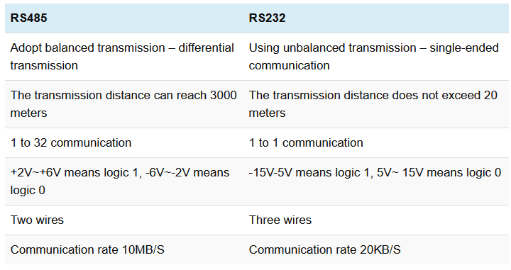
Difference Between RS 485 and RS 232
Difference Between RS 485 and RS 232

Slide 47
Serial Peripheral Interface (SPI)
The Serial Peripheral Interface Bus (SPI) is a synchronous bi-directional full duplex four wire serial interface bus. The concept of SPI is introduced by Motorola. SPI is a single master multi-slave system.
It is possible to have a system where more than one SPI device can be master, provided the condition only one master device is active at any given point of time, is satisfied.
SPI is used to send data between Microcontrollers and small peripherals such as shift registers, sensors, and SD cards.

Slide 48
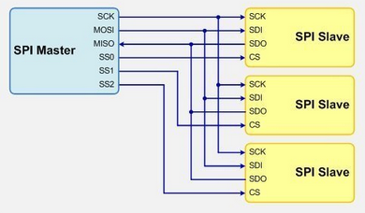
Serial Peripheral Interface (SPI)
.

Slide 49
I2C (Inter Integrated Circuit)
I2C:
Inter Integrated Circuit Bus (I2C - Pronounced as I square C) is a synchronous bi-directional half duplex (one-directional communication at a given point of time).
The concept of I2C bus was developed by Philips Semiconductors in the early 1980’s.
The original intention of I2C was to provide an easy way of connection between a microprocessor/microcontroller system and the peripheral chips in Television sets.
The I2C bus is comprised of two bus lines, namely: Serial Clock – SCL and Serial Data – SDA.

Slide 50
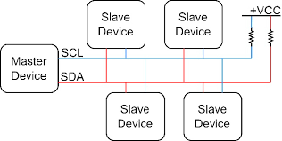
I2C (Inter Integrated Circuit)
I2C Bus

Slide 51
I2C (Inter Integrated Circuit)
I2C:
SCL line is responsible for generating synchronization clock pulses and SDA is responsible for transmitting the serial data across devices.
I2C bus is a shared bus system to which many number of I2C devices can be connected. Devices connected to the I2C bus can act as either Master device or Slave device.
The Master device is responsible for controlling the communication by initiating/terminating data transfer, sending data and generating necessary synchronization clock pulses.
Slave devices wait for the commands from the master and respond upon receiving the commands.
Master and Slave devices can act as either transmitter or receiver. Regardless whether a master is acting as transmitter or receiver, the synchronization clock signal is generated by the Master device only.
I2C supports multi masters on the same bus.

Slide 52
USB (Universal Serial Bus)
USB:
A common interface that is used to allow communication between different peripheral devices like mouse, digital cameras, printers, keyboards, media devices, scanners, flash drives & external hard drives as well as a host controller like a smartphone or PC is known as USB protocol.
There are different types of USB connectors available in the market where Type A and Type B are the most frequently used ones. At present, older connectors are replaced by Mini-USB, Micro-USB & USB-C cables.

Slide 53
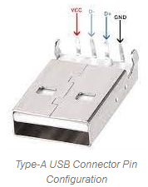
USB (Universal Serial Bus)
Pin Configuration of USB:
The typical Type-A USB connector is used in various applications.
These USBs include 4 pins that are given below.
This type of USB is observed mostly in connecting various devices to PC because it is the typical four-pin USB connector.
This connector is taller and narrower including 4-pins arranged within a box.
The pins of Type A USB are indicated with color wires to perform a particular function.
Pin1 (VBUS): It is a red color wire, used for providing power supply.
Pin2 (D-): It is a differential pair pin available in white color, used for connectivity of USB.
Pin3 (D+): It is a differential pair pin available in green color, used for connectivity of USB.
Pin4 (GND): It is a Ground pin, available in black color.

Slide 54
USB (Universal Serial Bus)
In the above pins, both the D+ & D- pins indicate the transfer of data. When a ‘1’ is sent across the wires, then the D+ line will have positive flow, and if ‘0’ is sent then the reverse happens.
How Does The USB Protocol Work?
The USB protocol simply works on the polling principle because, in polling, the processor continuously checks whether the input/output device is prepared for transmitting data or not. Thus, the I/O devices do not have to update the processor regarding their conditions because it is the main responsibility of the processor to check continuously. So this will make the USB low-cost & simple.

Slide 55
USB (Universal Serial Bus)
USB Protocol Features
The features of USB include the following.
The maximum speed of USB 2.0 is up to 480 Mbps.
An individual USB length can reach up to 40 meters including a hub and up to five meters without a hub
USB is a plug & play device.
It can draw power from a computer or through its own supply.
By using a single USB host controller, above 100 peripherals can be connected.
The power used by a USB device is up to 5 V & delivers up to 500 mA.
Once a computer changes into power-saving mode then some types of USBs convert automatically into sleep mode.
A USB includes two wires; one wire is used for power & another is used for carrying the data.
At 5V, the computer can provide power up to 500mA on the power wires.
Low-power-based devices can draw their power from the USB directly.
Two-way communication is possible by using a USB in between the computer & peripheral devices.

Slide 56
USB (Universal Serial Bus)
USB Standards and Specifications
The specifications of USB will change based on USB standards that include the following.
USB supports three types of speed low speed -1.5 Mbps, Full speed -12 Mbps & High speed – 480 Mbps.
USB 2.0 Standard
It is a high-speed USB with 480Mbps of maximum data transfer speed. This USB supports all connectors.
The maximum length of the cable is 5 meters.
Its max charging power is up to 15w.
USB 3.2 Standard
USB 3.2 (Generation1) is a super speed USB with 5Gbps of maximum data transfer speed.
It supports different connectors like USB 3 USB-A, USB 3 USB-B & USB-C.
The maximum length of cable for this USB is 3 meters.
Its max charging power is up to 15w.

Slide 57
USB (Universal Serial Bus)
USB Standards and Specifications
USB 3.2 (Generation2)
USB 3.2 (Generation2) is also a super speed USB with 10Gbps of maximum data transfer speed.
The maximum length of cable for this USB is 1meter.
It also supports different connectors like USB 3 USB-A, USB 3 USB-B & USB-C.
Its max charging power is up to 100w.
USB 3.2 Generation 2×2
USB 3.2 Generation 2×2 is a super speed USB with 20Gbps of maximum data transfer speed.
The maximum length of cable for this USB is 1meter.
It also supports USB Connector.
Its max charging power is up to 100w.

Slide 58
USB (Universal Serial Bus)
USB Standards and Specifications
Thunderbolt 3 Standard
This USB is also called thunderbolt including up to 40Gbps of maximum data transfer speed.
The maximum length of cable for this USB is 2 meters for active and 0.8meters for passive cables.
It supports USB Connector.
Its max charging power is up to 100w.
USB 4 Standard
This USB is also known as Thunderbolt 4 with up to 40Gbps of maximum data transfer speed.
The maximum length of cable for this USB is 2m for active & 0.8m for passive cables.
It supports USB Connector.
Its max charging power is up to 100w.

Slide 59
USB (Universal Serial Bus)
Advantages of USB
The advantages of USB include the following.
Easy to use.
For multiple devices, a single interface is used.
Its size is compact.
Its connector system is robust.
These are not expensive.
These are available in different sizes with different connectors.
Auto configuration.
Its expanding is easy.
High speed.
Reliable and low cost.
Power consumption is low.
Compatible and durable.
Disadvantages of USB
The disadvantages of USB include the following.
Some manufacturers design low-quality USBs with less cost.
Its capacity is limited.
As compared to other systems, its data transfer is not fast.
USB does not give the broadcasting feature, so individual messages are only communicated between the host & peripheral.

Slide 60

Bluetooth
Bluetooth is used for short-range wireless voice and data communication.
It is a Wireless Personal Area Network (WPAN) technology and is used for data communications over smaller distances.
It operates within the unlicensed, Industrial, scientific, and medical (ISM) bands from 2.4 GHz to 2.485 GHz.
Bluetooth stages up to 10 meters.
Depending upon the version, it presents information up to at least 1 Mbps or 3 Mbps.
The spreading method that it uses is FHSS (Frequency-Hopping Spread Spectrum).
A Bluetooth network is called a piconet and a group of interconnected piconets is called a scatternet.

Slide 61
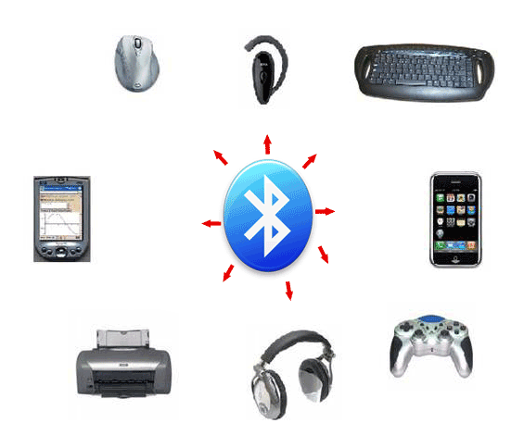
Bluetooth
Bluetooth simply follows the principle of transmitting and receiving data using radio waves.
It can be paired with the other device which has also Bluetooth but it should be within the estimated communication range to connect.
When two devices start to share data, they form a network called piconet which can further accommodate more than five devices.

Slide 62
Bluetooth
Key Features of Bluetooth
The transmission capacity of Bluetooth is 720 kbps.
Bluetooth is a wireless device.
Bluetooth is a Low-cost and short-distance radio communications standard.
Bluetooth is robust and flexible.
The basic architecture unit of Bluetooth is a piconet.

Slide 63
Bluetooth
Architecture of Bluetooth
The architecture of Bluetooth defines two types of networks:
Piconet: Piconet is a type of Bluetooth network that contains one primary node called the master node and seven active secondary nodes called slave nodes.
Thus, we can say that there is a total of 8 active nodes which are present at a distance of 10 meters.
The communication between the primary and secondary nodes can be one-to-one or one-to-many.
Possible communication is only between the master and slave.
Slave-slave communication is not possible.

Slide 64
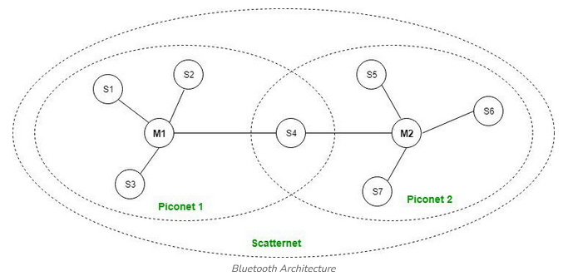
Bluetooth
Architecture of Bluetooth

Slide 65
Bluetooth
Architecture of Bluetooth
Scatternet:
It is formed by using various piconets.
A slave that is present in one piconet can act as master or we can say primary in another piconet.
This kind of node can receive a message from a master in one piconet and deliver the message to its slave in the other piconet where it is acting as a master.
This type of node is referred to as a bridge node. A station cannot be mastered in two piconets.

Slide 66
Bluetooth
Advantages of Bluetooth
It is a low-cost and easy-to-use device.
It can also penetrate through walls.
It creates an Ad-hoc connection immediately without any wires.
It is used for voice and data transfer.
Disadvantages of Bluetooth
It can be hacked and hence, less secure.
It has a slow data transfer rate of 3 Mbps.
Bluetooth communication does not support routing.

Slide 67
Zigbee
ZigBee is a technological standard created for controlling and sensing the network.
ZigBee is the Personal Area Network and it is based on IEEE 802.15.4 and is created by Zigbee Alliance.
ZigBee is an open, global, packet-based protocol designed to provide an easy-to-use architecture for secure, reliable, low power wireless networks.
ZigBee is a standard that addresses the need for very low-cost implementation of Low power devices with Low data rates for short-range wireless communications.
IEEE 802.15.4 supports star and peer-to-peer topologies. The ZigBee specification supports star and two kinds of peer-to-peer topologies, mesh and cluster tree.
ZigBee-compliant devices are sometimes specified as supporting point-to-point and point-to-multipoint topologies.

Slide 68
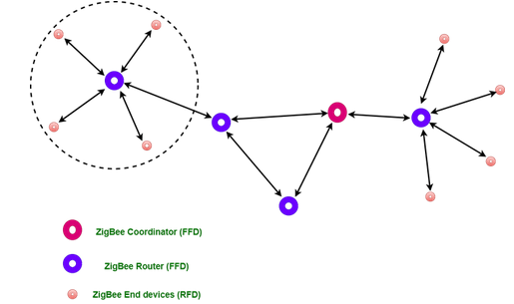
Zigbee
Types of ZigBee Devices:
Zigbee Coordinator Device: It communicates with routers. This device is used for connecting the devices.
Zigbee Router: It is used for passing the data between devices.
Zigbee End Device: It is the device that is going to be controlled.

Slide 69
Zigbee
General Characteristics of Zigbee Standard:
Low Power Consumption
Low Data Rate (20- 250 kbps)
Short-Range (75-100 meters)
Network Join Time (~ 30 msec)
Support Small and Large Networks (up to 65000 devices (Theory); 240 devices (Practically))
Low Cost of Products and Cheap Implementation (Open Source Protocol)
3 frequency bands with 27 channels.
Operating Frequency Bands (Only one channel will be selected for use in a network):
Channel 0: 868 MHz (Europe)
Channel 1-10: 915 MHz (the US and Australia)
Channel 11-26: 2.4 GHz (Across the World)

Slide 70
Zigbee
Zigbee Network Topologies:
Star Topology (ZigBee Smart Energy): Consists of a coordinator and several end devices, end devices communicate only with the coordinator.
Mesh Topology (Self Healing Process): Mesh topology consists of one coordinator, several routers, and end devices.
Tree Topology: In this topology, the network consists of a central node which is a coordinator, several routers, and end devices. the function of the router is to extend the network coverage.

Slide 71
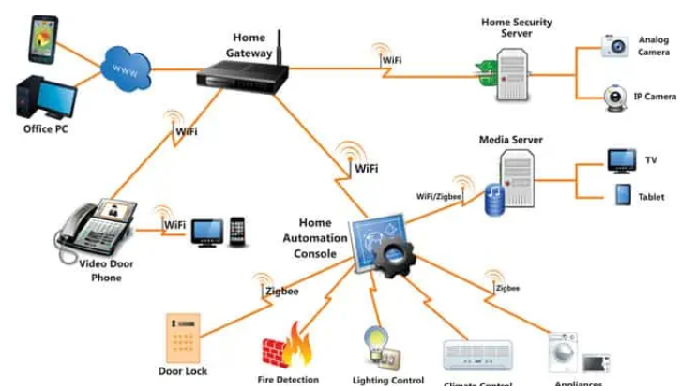
Zigbee
Zigbee Network:

Slide 72
Zigbee
Zigbee Applications:
Home Automation
Medical Data Collection
Industrial Control Systems
meter reading system
light control system
Commercial
Government Markets Worldwide
Home Networking

Slide 73
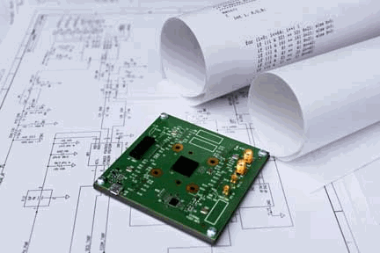
Real Time Embedded Systems
One of the earliest decision points in embedded systems design is whether the system will require real-time computing capabilities
From controlling elevators, stoplights, the valves of your washing machine or even how long your toaster toasts, embedded computing is everywhere.
Real time systems are those systems that work within strict time constraints and provide a worst case time estimate for critical situations
Think of a car’s airbag deployment system. If the microcontroller doesn’t detect a collision or electronically trigger the airbag within a fraction of a second, the result is tragic.
Real time computing describes the ability to react to inputs and deliver the prescribed output within a constrained time frame. Devices that use real-time computing are deployed in applications where their correct functioning can make the difference between life and death.

Slide 74
Embedded Systems v/s Real Time Embedded Systems
Feature | Embedded System | Real-Time Embedded System
Definition | Specialized computing system performing dedicated functions within a larger system | Subset of embedded systems designed to perform tasks within strict timing constraints
Timing Constraints | May or may not have real-time constraints | Always have strict timing constraints
Application Sensitivity | Timing is less critical Focus on reliability and functionality | Timing is crucial Deadlines must be met to avoid unacceptable consequences
Design Complexity | Can range from simple to complex, focusing on functionality, efficiency and cost | Generally more complex due to the need to guarantee timely responses, predictability, and reliability

Slide 75
Real Time Systems
A real time system is a system that reacts to events in the environment by performing predefined actions WITHIN SPECIFIED TIME INTEVALS
I/O - data
event
time
Real-time
computing system
action
I/O - data

Slide 76
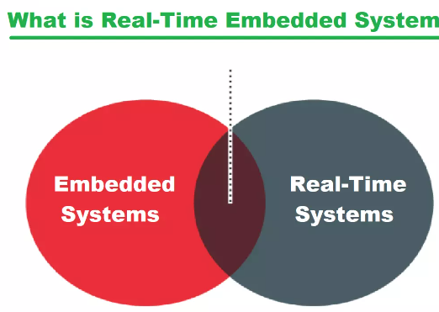
Real Time Embedded Systems
The embedded systems which respond to real time situation with the help of its embedded software and hardware, within the specified time constraints are called real time embedded systems

Slide 77
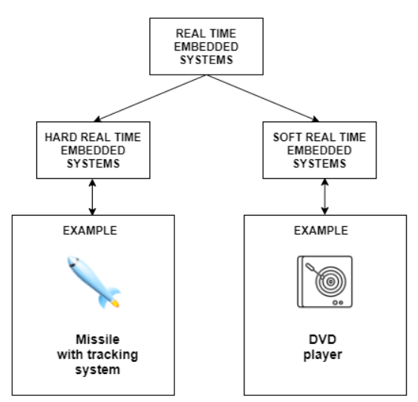
Real Time Embedded Systems
The Real time System is a system which is used for performing some specific tasks.
The tasks assigned to real-time systems need to be completed in given time interval.
A real-time embedded system combines the technologies of embedded systems and real-time computing. To achieve the most complete and accurate description

Slide 78
Real Time Operating System (RTOS)
An RTOS is used for embedded systems applications that are time sensitive or time critical.
in a time-critical system, the value of completing a task is linked to its timeliness and tasks that are completed past the deadline may have a negative value.
RTOS includes a task scheduler component whose goal is to ensure that critical tasks meet their deadline, even when it means sacrificing other areas of performance.

Slide 79
Characteristics of RTES
Constant Response: A real-time embedded system always responds in the same manner to a certain situations, it is not allowed to deviate from its normal designated output.
Deadline: A deadline is crucial to the working of an embedded system, a missed deadline can cost lives and finances
Accuracy: Accuracy is important characteristic for RTES. what would happen if the pacemaker can't maintain the heartbeat, patient would eventually die.
Quick Response: The real-time embedded system must be swift enough to respond to the changing external environment with immediate effect

Slide 80
Examples of RTES
Domain | Application
Avionics | Navigation; displays
Multimedia | Games; simulators
Medicine | Robot surgery; remote surgery; medical imaging
Industrial systems | Robot assembly lines; automated inspection
Civilian | Elevator control Automotive system; Global positioning system (GPS)

Slide 81
Types of RTES

Slide 82
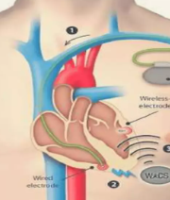
Hard Real Time Embedded System
This type of system makes sure that all critical processes are completed within the given time frame.
This means that all the delays in the system are strictly time bound.
Also, there is little to no secondary memory and data is stored in short term memory or read only memory.
Hard real time systems are used in various areas such as missiles, airplanes etc.
Pacemaker

Slide 83
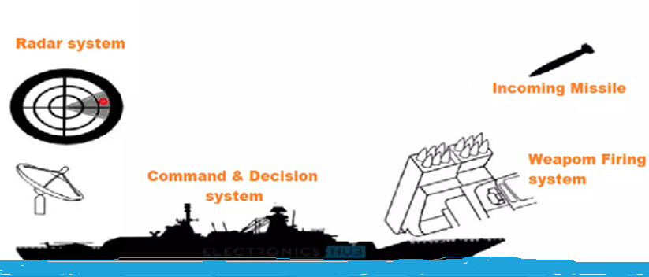
Hard RTES Example
Example of Hard RTES

Slide 84
Hard Real Time Embedded System
Advantages:
Reliability and Predictability: Ensures that critical tasks are completed within strict deadlines, which is essential for safety-critical applications.
Safety: Suitable for applications where failure to meet deadlines can result in catastrophic consequences, ensuring safety and compliance with regulatory standards.
Deterministic Behavior: Provides precise and deterministic system behavior, which is crucial for applications requiring high levels of precision and control.
Disadvantages:
Complexity and Cost: Designing and implementing hard real-time systems is complex and costly due to stringent timing and reliability requirements.
Resource Utilization: Often requires over-provisioning of resources to guarantee deadlines, leading to potentially inefficient resource utilization.
Inflexibility: Lack of flexibility in handling dynamic workloads and changes in the system environment, as strict adherence to deadlines is mandatory.

Slide 85
Soft Real Time Embedded System
This These are much less constrictive than hard real time systems but the basic premise is the same i.e critical processes need to be completed within the given time frame.
However, this time frame can be a little flexible.
Soft real time systems are used in various areas such as multimedia, scientific projects etc.

Slide 86
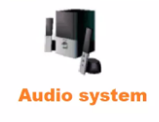


Soft RTES Example
Examples of Soft RTES

Slide 87
Soft Real Time Embedded System
Advantages:
Flexibility: Can handle dynamic and variable workloads, making them suitable for applications where occasional deadline misses are acceptable.
Efficiency: Higher resource utilization as the system can overcommit resources and manage priorities dynamically.
Cost-Effective: Generally cheaper to develop and maintain compared to hard real-time systems due to more relaxed timing constraints.
Disadvantages:
Unpredictability: Performance can be less predictable, and occasional deadline misses can lead to a degradation of service quality.
Suitability: Not suitable for safety-critical applications where missing deadlines can have severe consequences.
Quality Variability: The quality of service may vary depending on the system load and priority management, leading to potential user dissatisfaction.

Slide 88
Firm Real Time Embedded System
In a firm RTES, errors are occasionally permissible but there is an understanding that missed deadlines result in degraded performance of the device.
A device using a firm RTES may occasionally miss a deadline, but the application can recover as long as failures are relatively infrequent.

Slide 89
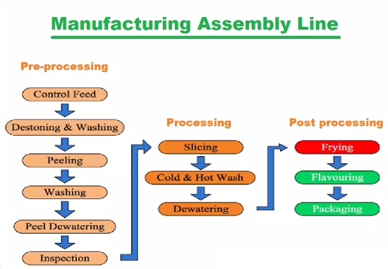
Firm RTES Example
Example of Firm RTES
A fully automated assembly line doesn't crash when a task isn't performed in time, it rather ignores that missed part and continues to complete the rest.

Slide 90
Firm Real Time Embedded System
Advantages:
Balanced Approach: Combines the reliability of hard real-time systems with the flexibility of soft real-time systems, offering a balanced solution for many applications.
Tolerance for Occasional Misses: Can tolerate occasional deadline misses without catastrophic consequences, making them suitable for a wide range of applications.
Resource Optimization: Can achieve a good balance between resource utilization and deadline adherence, optimizing overall system performance.
Disadvantages:
Complexity: Balancing strict deadlines with occasional flexibility adds complexity to system design and implementation.
Resource Management: Requires careful management of resources to ensure that the system remains reliable while allowing some flexibility.
Potential for Degradation: Repeated or excessive deadline misses can still lead to significant performance degradation or system errors, requiring robust handling mechanisms.

Slide 91
Hard v/s Soft v/s Firm
Feature | Hard Real-Time Embedded Systems | Soft Real-Time Embedded Systems | Firm Real-Time Embedded Systems
Definition | Systems where missing a deadline can lead to catastrophic failures. | Systems where missing a deadline can degrade performance but is not catastrophic. | Systems where missing a deadline occasionally is tolerable but repeated misses are problematic.
Examples | Airbag systems, pacemakers, industrial control systems | Multimedia systems, online transaction processing | Automated teller machines (ATM), navigation systems
Deadline Importance | Strict and non-negotiable | Flexible, negotiable within limits | Generally strict, but some deadlines can be missed occasionally
Consequences of Missing Deadlines | Catastrophic failures, possible loss of life or major system failures | Reduced quality of service, performance degradation | Degradation in quality, potential for system errors if repeated misses occur
System Predictability | Highly predictable and deterministic | Less predictable, can tolerate some variability | Predictable with some tolerance for infrequent deadline misses
Scheduling Approach | Priority-based or time-triggered | Best-effort or dynamic priority-based | Mixture of hard and soft real-time scheduling
System Design Complexity | High, due to need for strict timing guarantees and predictability | Moderate, balancing performance and deadline adherence | Moderate to high, depending on tolerance for deadline misses
Typical Use Cases | Critical systems where safety and reliability are paramount | Consumer electronics, telecommunication systems | Financial systems, some mission-critical applications with tolerance for occasional misses

Slide 92
Common Scheduling Algorithms for Real time systems
Rate Monotonic Scheduling (RMS): This algorithm assigns static priorities to tasks based on their periods, with shorter periods receiving higher priorities. It is suitable for periodic task sets and provides a simple and efficient scheduling mechanism.
Earliest Deadline First (EDF): In this algorithm, tasks are scheduled based on their absolute deadlines, with the task having the earliest deadline receiving the highest priority. EDF is an optimal scheduling algorithm for preemptive task sets and can achieve higher processor utilization than RMS.
Least Laxity First (LLF): This algorithm schedules tasks based on their laxity, which is the amount of time remaining before a task's deadline minus its remaining execution time. Tasks with lower laxity values are given higher priorities, as they have less flexibility in meeting their deadlines.
Priority-based Scheduling: In this approach, tasks are assigned static or dynamic priorities based on various factors, such as importance, criticality, or deadline requirements. Higher-priority tasks are scheduled before lower-priority tasks.

Slide 93
Types of Event to trigger RTES
Periodic
activity occurs repeatedly
e.g., to monitor environment values, temperature, etc.
period
time
periodic

Slide 94
Types of Event to trigger RTES
Aperiodic
can occur any time
no arrival pattern given
time
aperiodic
aperiodic

Slide 95
Types of Event to trigger RTES
Sporadic
can occur any time, but
minimum time between arrivals
mint
time
sporadic

Slide 96
Typical Real time system example
Temperature sensor
Input port
CPU
Memory
Output port
Heater

Slide 97
Typical Real time system example
While true do
{
read temperature sensor
if temperature too high
then turn off heater
else if temperature too low
then turn on heater
else nothing
}

Slide 98
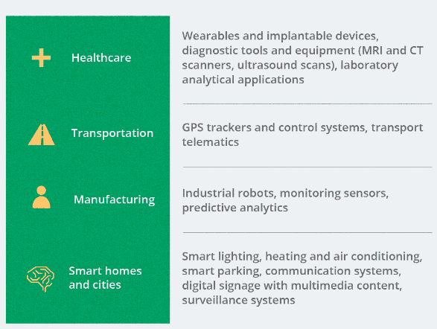
Applications of RTES

Slide 99
Thank you

